Slide 1






Mastering Prompt Engineering
Xavier Morera
Helping developers create epic applications
www.xaviermorera.com / www.bigdatainc.org / www.lupo.ai

Slide 2


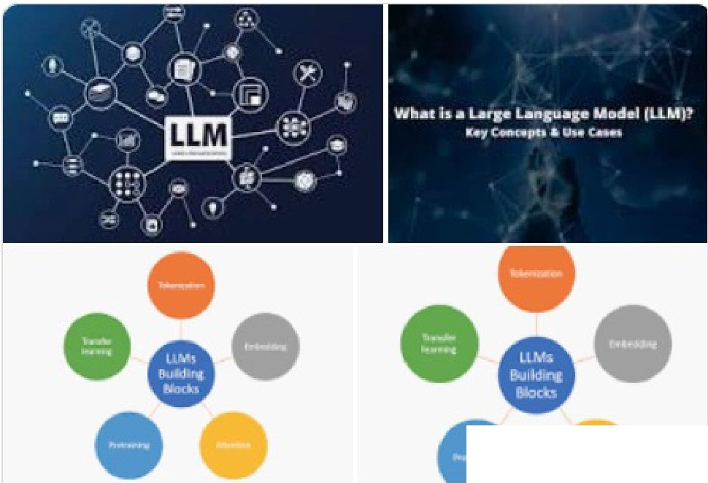
Go gle
what is an llm
X
•••
••••••
Q. All
Images
[!] Videos
Books
News
: More
Tools
SafeSearch ....
About 250,000,000 results (0.42 seconds)
TechTarget
https://www.techtarget.com > l¹arge-lan.guage-model-LLM :
What are Large Language Models? I Definition from ...
A large language model (lLM) is a type of artificial intelligence (Al) algor,ithm that uses deep learning techniques and massively large data sets to ....
Deep learning • How do Big Data and Al Work... • Transformer neural networks
People also ask
What is the meaning of LLM?
V
GJ More i
m
ages
What is an LLM in All?
Large language model
V
What is the difference between LLM and Al?
V
A large language model is a type of language model notable for its ability to achieve general-pu pose
What are lLMs examples?
V
language understanding and generation. Wilkipedia
Feedback
Feedback
ID Computerworld
https://www.computeNVorld.com > article > what-are-I... :
What are LLMsl and how are they used in generative Al?
May 30, 2023 -An LLM is a machine-learning neuro network trained throug1h data
input/output sets; frequently, the text is unlabeled or u1ncategorized, and the ...
W Wikipedia
https://en.wikfpedia.org > wiki1> Large_language_model :

Slide 3

[]
Default (GPT-3.5)
L!J
What is an LLM (Larg1e Language Model)?
IJ
An LLM, or Large Lang1uage Model, is a type of artificial intelligence system that has been trained on a massive amount of text data to understand and generate human-llike text. These models are designed to process and generate natural language, making them particularly adept at tasks such as text generation, text completion, translation, text summarization, and more. LLMs are based on deep learning techniques, specifically neural networks, and they are capable of understanding and generating text in multipile languages.
□ rb Ql
One of the most well-known examples of an LLM is GPT-3 (Generative Pre-trained Transformer 3), which was developed by OpenAL GPT-3 has 175 billion parameters and can generate coherent and contextually relevant text based on the input it receives.
LLMs have a wide rang1e of applications, including natural language understanding, chatbots, virtual assistants, content generation, language translation, sentiment analysis, and more. They have significantly advanced the state of the art in natural language processing and have the potential to revolutionize various industries and applications by
automating or enhancing language-related tasks.
'Si Regenerate
end a message
?.
Free Research Pr,eview. ChatGPT may produce inaccurate information about people, places, or facts. ChatGPTSeRtember 25 Version

Slide 4

Understanding Prompting

Slide 5

Prompt
Input provided by users or programmers to get a response from an LLM

Slide 6

Prompt
Input provided by users or programmers to get a response from an LLM
Establishes the context and offers instructions that guilde the LLM to create a relevant and meaningful response

Slide 7
Prompt Sample
"Write a story on a traveling computer programmer"

Slide 8
Natural language
Prompt
How we speak in real life
Prompts bridge the gap between human intention and machine-generated responses

Slide 9
Crafting effective prompts is pivotal in ensuring that an LLM produces accurate and valuable responses

Slide 10
Crafting Effective Prompts
Good
Write about technology.
Better, Best, Way Better...
Write an engaging blog post about the impact of artificial intelligence on everyday life, highlighting both its benefits and potential concerns.

Slide 11
Anatomy of an Effective Prompt

Slide 12

Anatomy of an Effective Prompt
Contextual information
Clarity
Specificity
Desired format
Length constraints
Examples or hints

Slide 13
A clear prompt is easy for both humans and AI models to understand
Clarity
It should convey your request or question without ambiguity

Slide 14
An effective prompt is specific and well-defined
Specificity
It should clearly state the information or data you want from the AI model

Slide 15
Including relevant context can help the AI model generate more accurate responses
Contextual Information
Provide background information or constraints, if necessary

Slide 16
Desired Format
Specify the format you want the answer in
It can be a list, paragraph, chart, or any other format that suits your needs

Slide 17

Length Constraints
Specify the desired length, as a guide for the AI model

Slide 18
Examples or Hints
Providing examples or hints can clarify your request and guide the AI model

Slide 19
An invaluable rule when creating prompts!
Avoid bias or controversy

Slide 20
An invaluable rule when creating prompts!
Avoid Bias or Controversy

Slide 21


Avoid Bias or Controversy
Use neutral and inclusive language
Avoid framing questions in a way that assumes or promotes stereotypes or discrimination
Ensure prompts do not introduce bias
Consider other perspectives
Test prompts with a diverse group of people to identify and address potential issues

Slide 22

Multiple Prompts for Complex Tasks
For complex tasks
- Consider breaking down your prompt
Multiple prompts may explain the scenario in a much better way

Slide 23
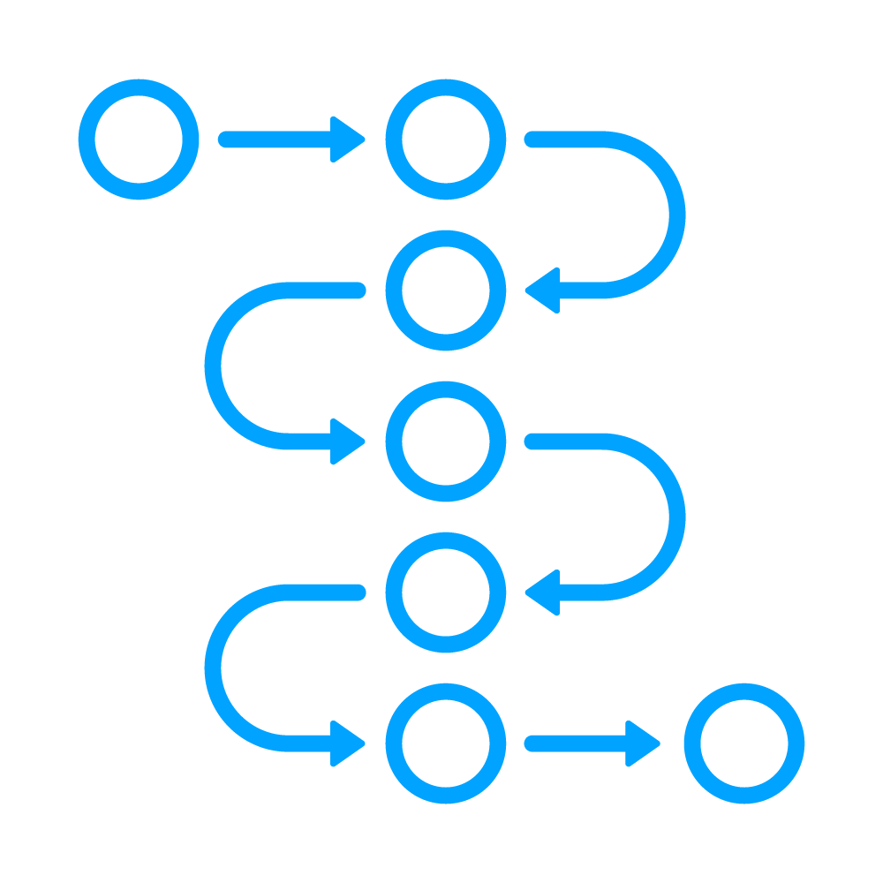
Iteration and Refinement
Iterate and refine prompts
Experimentation is key
- Try different phrasings
Review results, identify weaknesses, seek feedback, test again, and repeat as needed

Slide 24
Tokenization

Slide 25
Toke what?

Slide 26

Toke what?

Slide 27
Tokenization
Process of splitting a text sequence
Into smaller units
Called "tokens"
Tokens are the smallest meaningful elements or symbols in a text
Derived from the concept of linguistic tokens
Units of language that convey meaning

Slide 28
Tokenization Example
The quick brown fox jumps over the lazy dog

Slide 29
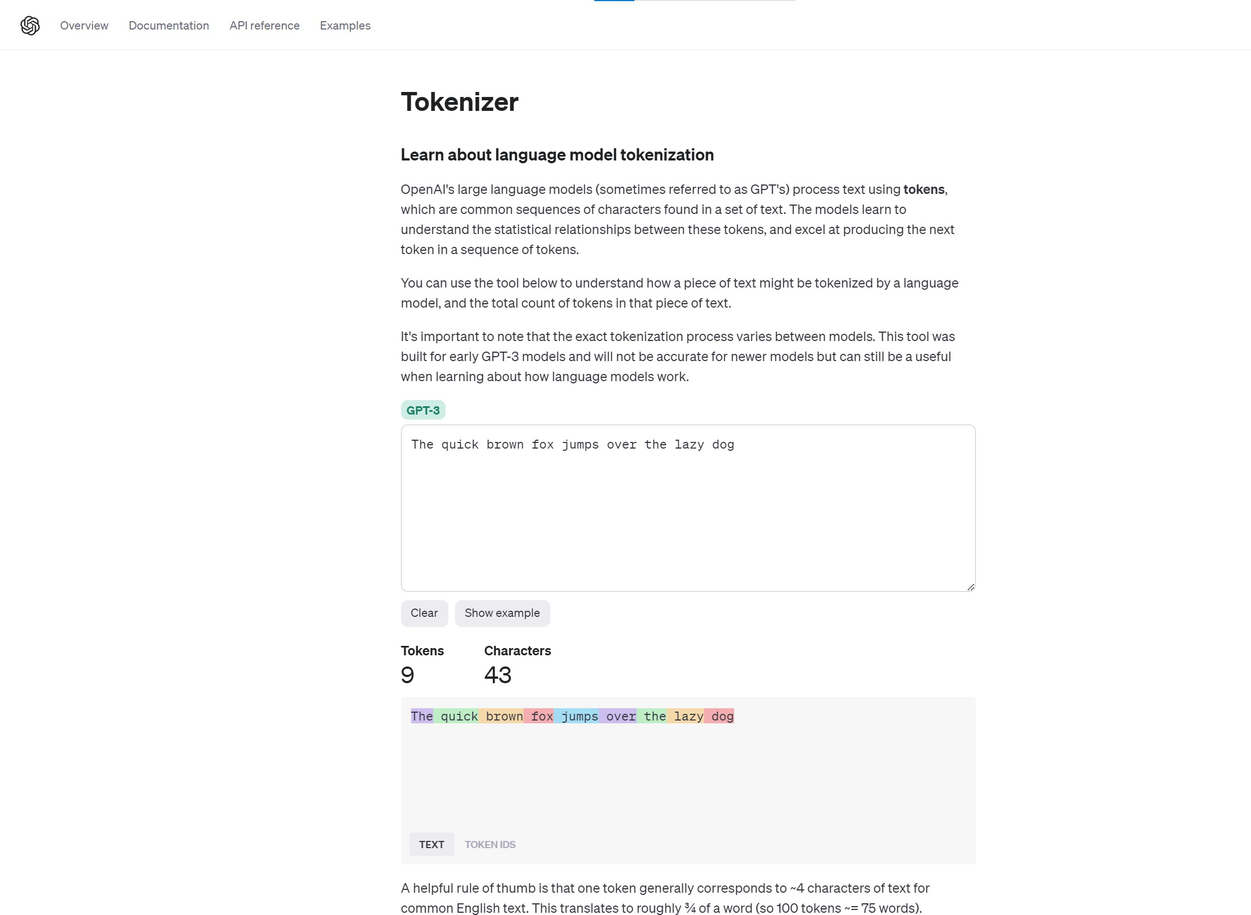



Slide 30
Importance of Tokenization
Text processing
Analysis and statistics
Language modeling
Computational efficiency
Vocabulary mapping
Preprocessing and post- processing

Slide 31
The OpenAI Playground

Slide 32


Slide 33



Overview
Documentation
API reference
Examples
Playground
Fine-tuning
Upgrade
0) Forum
(i) Help,
Lupo.ai
Get started
X
Playground
[ Your presets
Save
View code
Share
Enter an instruction or select a preset, and watch the API respond with a completion that attempts to match the context or pattern you provided.
Mode
SYSTEM
You are a helpful assistant.
USER
Enter a user message here.
Chat
V
You can control which model completes your request by changing the model.
Model
0 Add message
gpt-3.5-turbo
V
KEEP IN MIND
Temperature
------o
Maximum length
1
Use good judgment when sharing outputs, and attribute them to your name or company. Learn more.
256
-'y-
Requests submitt,ed to our
API and Playground will not be
used to train or improve future models. Learn more.
Stop sequences
Enter sequence and press Tab
EJ Our default models' training data cuts off in 2021, so they may not have knowledge of current events.
Top P
1
-----------o
Frequency penalty 0
0
Presence penalty
0
Submit
0

Slide 34

The OpenAI Playground
Web-based tool
Allows you to test prompts
Get familiar with the API
Test different models and settings
Can save presets
Share
View code

Slide 35

The OpenAI Playground

Slide 36
Context is king!
Use system messages!

Slide 37
Prompting Best Practices

Slide 38
Prompting Best Practices
a.k.a. Crafting Effective Prompts

Slide 39
Clearly articulate what you want
Avoid vague or ambiguous language
Be clear and specific
Tell me about dogs
Specify the type of information or action you're looking for
What are the most common breeds of dogs?

Slide 40
Write prompts in natural, conversational language that a human would use
Use natural language
Avoid overly technical or formal language
Frame questions as if you were asking a knowledgeable friend for help

Slide 41
Include relevant context in your prompt
Explain the situation or background information
If necessary
If the conversation has a history
Refer back to previous messages to maintain the context
Provide context

Slide 42
Encourage detailed responses by asking open-ended questions
Can't be answered with a simple yes or no
For example, instead of asking
Is it raining?
You can use
What's the weather like today?
Ask open-ended
questions

Slide 43
Consider breaking down complex questions into multiple smaller questions
Easier for the AI model to provide accurate responses
For example, if I want to know about a city
Ask separate questions about its history, attractions, and local cuisine
Instead of
Tell me everything about the city
Break down complex questions

Slide 44
Steer clear of double negatives or confusing phrasing that could lead to misinterpretation
Avoid double negatives
For instance, instead of saying
Isn't it unlikely that this won't work?
Simply ask
Will this work?

Slide 45
Identify and use keywords related to your topic
Helps the model understand the subject matter better
Helps provide more relevant responses
If you're asking about AI ethics, include terms like machine learning, artificial intelligence...
Use relevant keywords

Slide 46
Experiment with different prompts
Analyze output
Determine which ones yield the best results
AI models may respond differently to slight variations in wording
Don't hesitate to iterate and refine your prompts based on the AI's responses
Test and iterate

Slide 47
Maintain a polite and respectful tone in all your prompts
Be polite and respectful
AI model should be treated with the same courtesy as a human
Avoid offensive or inappropriate language

Slide 48
Gather feedback from real users to fine-tune your prompts
Test with real users
They can provide valuable insights into the effectiveness of your questions

Slide 49

>-
•
0
openai / openai-cookbook
Q Type (Z) to search
+ ....
0 141 g
< > Code 0
Issues 44 11 Pull requests
3 0 Actions
0 Security
lnslghts
$1 openai-cookbook
Public
0 Watch 790 ,.
'-/ Fork 8.1k
* Star 49.3k
l' main ...
1-' 5 branches
'O O tags
Go to file
Add file,.
<> Code ....
About
Examplles and guides for using the OpenAI APII
simonpfish add function calling tags
ccablfe 2 hours ago 0
690 commits
II II
.github
Polish PR template and rubric
yesterday
c:> cookbook.openai.eom
docs openai gpt-3 chatgpt
article•s
Fix image links
4 hours ago
gpt-4
1111
examples
Update title and reformat with prettier
2 hours ago
•
[I]
6-LI
-1\r
Readme
MIT license Activity
images
Update README to point to website (#732}
last month
C) .gitignore
Add description and rename Obtain_dataset, and throw error when fi...
last month
C) CONTRIBUTING..md
Polish PR template and rubric
yesterday
*
49.3k stairs
C)
llCENSE
Create LICENSE (#136)
8 months ago
0
790 watching
8.1k forks
C) README.md
Update contributions process (#784)
5 days ago
'-I
Report repository
C)
reg1istry.yarnI
add function calling tags
2 hours ago
REAOME.md
Used by 11
@ OpenAI Cookbook
,..·'
@cram1k / tomfool
I • Navigate at cookbook.openai.com
Exampllle code and guides for accompmshing common tasks with the OpenAI APL To run these examplesr you'll
Contributors 148

Slide 50


README..md
Used by 11
@ OpenAI Cookbook
· @cram1k / tomfool
I • Navigate at cookbook.openai.com
Exampllle code and guides for accomp!!ishing common tasks with the OpenAI APL To run these examples,.you'll need an OpenAI account and associated API key (create a free account here).
Contributors 148
Most code examples are writtenn Python, though the concepts can be applied in any language.
+137 contributors
For other useful tools, guides and courses, check out these related resources from around the web.
Co,ntributing &
The OpenAI Cookbook is a community-driven resource. Whether you're submitting an idea, fixing a typo, adding a new guide·, or improving an existing one, your contributions are greatly appreciated!
Before contributing1, read through the existing issues and pulll requests to see if someone else is .already working1 on something similar. That way you can avoid duplicating efforts.
If there are examples or guides you'd like to see, fee!IIfree to sugigest them on the issues page.
If you'd like to contribute new content, make sure to read through our contribution guidelines. We wellcome high­ quality submissions of new examples and guides, as long1as they meet our criteria and fit within the scope of the cookbook.
The contents of this repo are automatically rendered into cookbook.openai.com based on registry.yam!.
I
O
Open in GitHub Codespaces

Slide 51
@openAI Cookbook
Albout API Docs ?I Contribute0
Q Search...
XK
Popular
How to call functions with chat models
How to count tokens with tiktolken
Data preparation a1nd analysis for chat
model fine-tuni;ng
Jun 13, 2023
COUPLETIONS FUNCTIONS
Dec 16, 2022
COMPLETIONS llKTOKEN
Aug 22, 2023
COMPLETIONS TIKTOKEN
How to stream completions
Question answering using embeddings­ based search
How to format inputs to ChatGPT models
Sep 2, 2022
COMPLETIONS TIKTOKEN
Jun 10, 2022
COMPLETIONS EMBEDDINGS
Mar 1, 2023
COMPLETIONS TIKTOKEN
Featured
How to build an agent with the Node.js
SDK
Related resources from around the web
Technmques to improve reli'ability
Oct 5, 2023
COMPLETIONS fUNCTIONS
Jan 20, 2023
COMPLETIONS EMBEDDINGS
Sep 12, 2022
COMPLETIONS
How to work with large language models
How to fine..tune chat models
Evaluating Abstractive Summarizatio,n
Jan 20, 2023
COMPLETIONS
Aug 22, 2023
COMPLETIONS
Aug 16, 2023
COMPLETIONS EMBEDDINGS
All 11s
Filter v
How to build an agent with the Node.js SOK
COMPLETIONS
FUNCTIONS
Oct5,2023

Slide 52

@OpenAI Cookbook
About API Docs JI Contribute r')
Q Search...
How to stream completions
led Sanders
Sep 2, 2022
0 Open in Github
By default, when you request a completion from the OpenAI, the entmre completion is generated before being sent back in a single response.
llf you're generating long completions, waiting for the response can take many seconds.
To get responses sooner, you can 'stream' the complletion as ilt11s being generated. This allows you to start printing or processing the beginning of the completion before the full completion is finished.
To stream completions, set st ream=True when calling the chat completions or completions endpoints. This wiU return an object that streams back the response as data-onlv.server-sent events. Extract chunks from the delta field rather than the message fielld.
Downsides
Note that using stream=True in a production application makes it more difficult to moderate the content of the completions, as partial completions may be more difficult to evaluate. This may have implications for ilP-P-roved usagg.
Another small drawback of streaming responses is that the response no longer includes the usage field to tell you how many tokens were consumed. After receiving and combining alll of the responses, you can calcuilate this yourself using tiktoken .

Slide 53
Six Best Practices for Prompt Engineering

Slide 54
Six Best Practices for Prompt Engineering
Write clear instructions
Provide reference text
Split complex tasks into simpler tasks
Give GPT time to "think"
Use external tools
Test changes systematically

Slide 55
Write Clear Instructions

Slide 56


Write Clear Instructions
Include details in your query to get more relevant answers
Ask the model to adopt a persona
Use delimiters to clearly indicate distinct parts of the input

Slide 57
Write Clear Instructions
Specify the steps required to complete a task
Provide examples
Specify the desired length of the output

Slide 58
Write clear instructions

Slide 59
Provide Reference Text

Slide 60
Provide Reference Text
Instruct the model to answer using a reference text
Instruct the model to answer with citations from a reference text

Slide 61
Provide reference text

Slide 62
Split Complex Tasks into Simpler Subtasks

Slide 63
Split Complex Tasks into Simpler Subtasks
Use intent classification to identify the most relevant instructions for a user query
For dialogue applications that require very long conversations, summarize or filter previous dialogue
Summarize long documents piecewise and construct a full summary recursively

Slide 64
Split complex tasks into simpler subtasks

Slide 65
Give GPTs Time to "Think"

Slide 66
Give GPTs Time to "Think"
Instruct the model to derive its conclusion through reasoning from fundamental principles
Employ inner monologue or a sequence of queries to conceal the model's reasoning process
Prompt the model to identify any previously overlooked content

Slide 67
Give GPTs time to "think"

Slide 68
Use External Tools and
Test Changes Systematically

Slide 69

Use External Tools
GPT is not a one-size-fits-all solution
There are other tools that perform better in certain scenario
Use the tool that best solves a problem

Slide 70


Test Changes Systematically
You can’t improve what you don’t measure
A change may improve responses for certain prompts but may affect overall performance
Define a comprehensive test suite (eval)

Slide 71
A Few Final Words on Prompt Engineering

Slide 72
A Few Final Words on Prompt Engineering
Use clear and concise language
Provide examples of the desired output
Break down complex prompts
Provide feedback to the LLM and iterate

Slide 73
A Few Final Words on Prompt Engineering
Use active voice
Use positive language
Use keywords that are related to your topic
Use prompts that are consistent with the training data

